Slide 1
How to add Arduino library

Slide 2




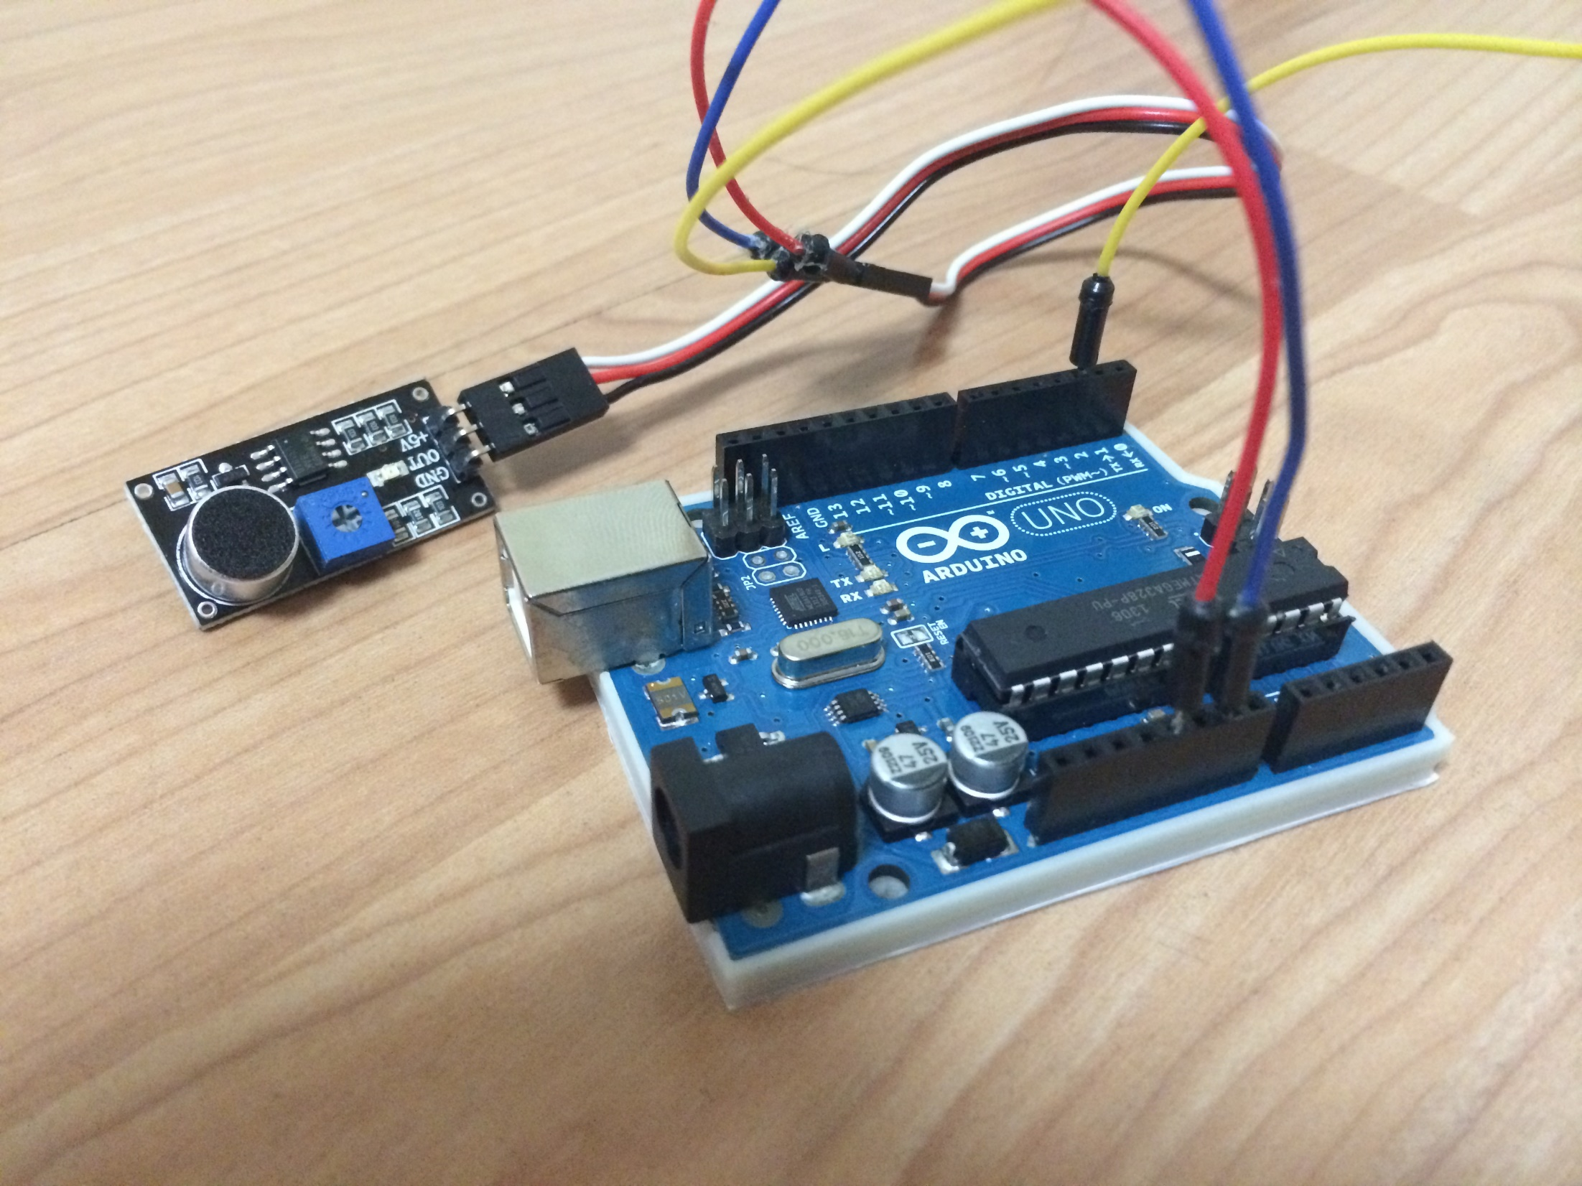
라이브러리란? - What is Library?
A collection of frequently used partial programs(=function) in a computer program.(WIKI)
Brief description: Functions required for program creation
Compare Description: Car Wheel, Car Headlight, Car Airbag
GOAL
Assembly
Example(IOT Sensor)
Sensor on
Sensor off
Get Sensor value
……..
has many functions.
Sensor operation

Slide 3
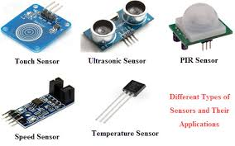



Who make the library?
Sensor manufacturing company
Provide library
We just use Library
Some developers
You can make it yourself

Slide 4
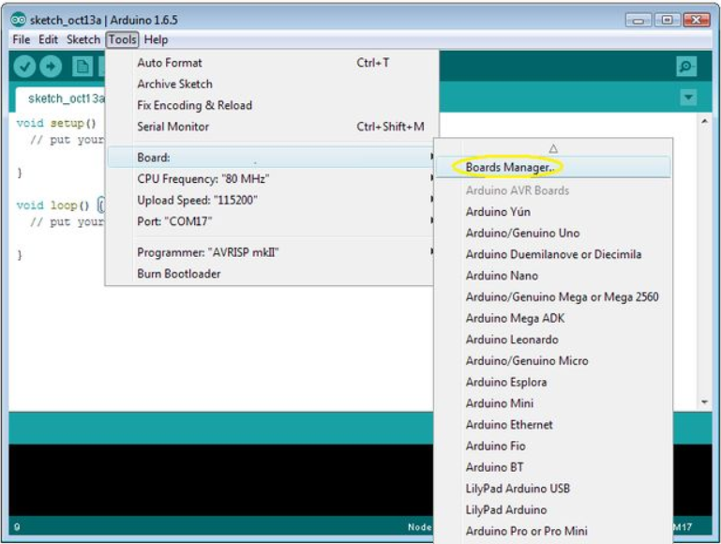
How to add Arduino library
There are two ways to add the library in Arduino IDE
First 1
Select "Tools> Board> Boards Manager".

Slide 5
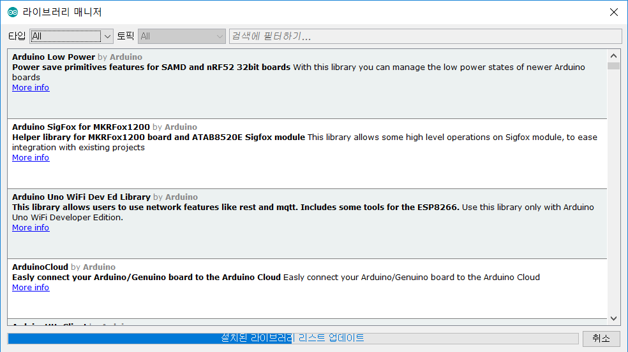
How to add Arduino library
First 2
Select "Tools> Board> Boards Manager".
You can find the library by searching.
However, sometimes there are no libraries.

Slide 6
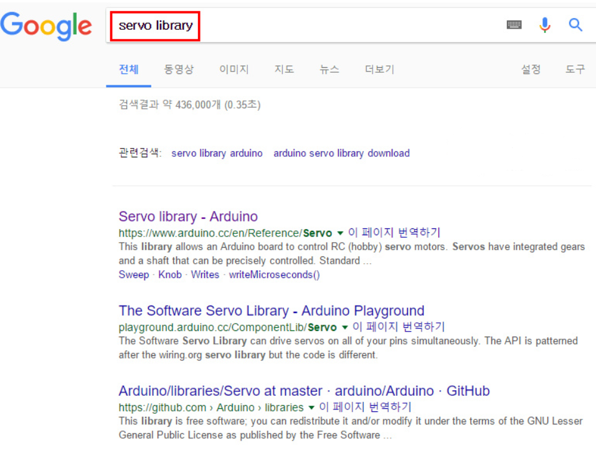
How to add Arduino library
Second-1
Search the library.(ex. Use the Servo-Motor-library)

Slide 7

How to add Arduino library
Second-1
Search the library in the GITHUB.

Slide 8
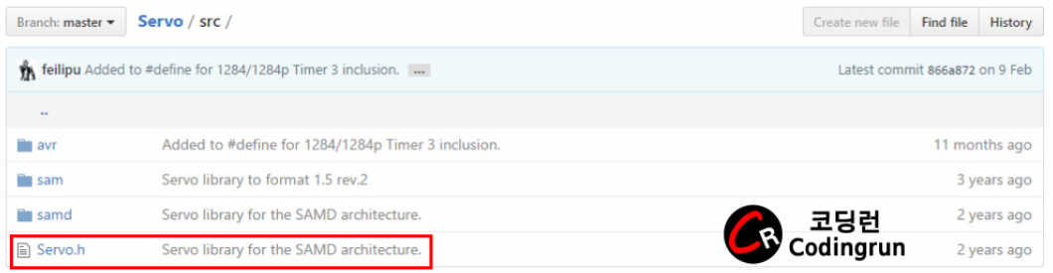
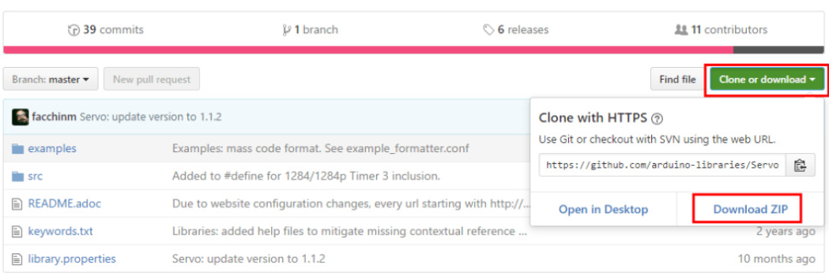
How to add Arduino library
Second-2
Clone or download -> Download ZIP

Slide 9
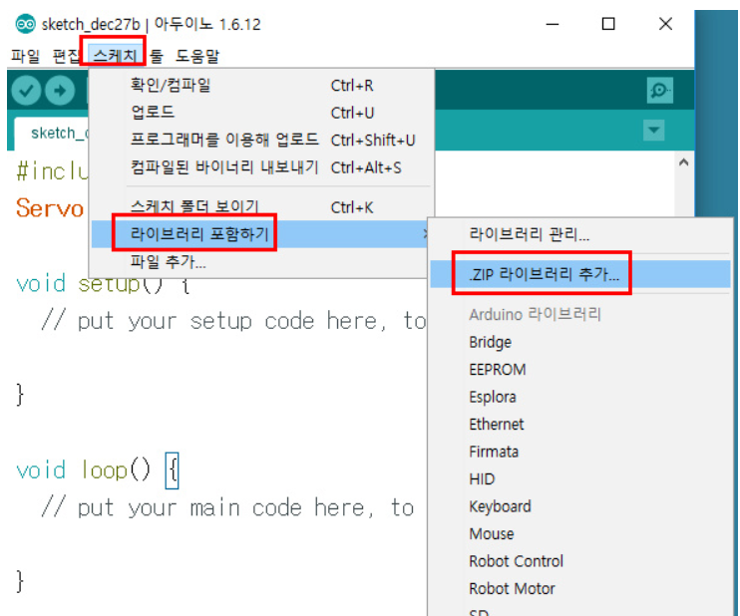
How to add Arduino library
Second-3
Select “Sketch> include Library> Add ZIP Library".

Slide 10
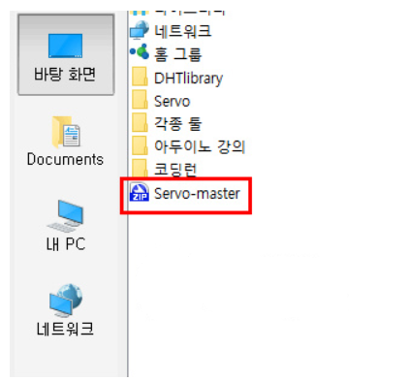

How to add Arduino library
Second-4
Select “Sketch> include Library> Add ZIP Library".
Go to the downloaded folder and
add the downloaded file
Libraries are usually built this way.

Slide 11
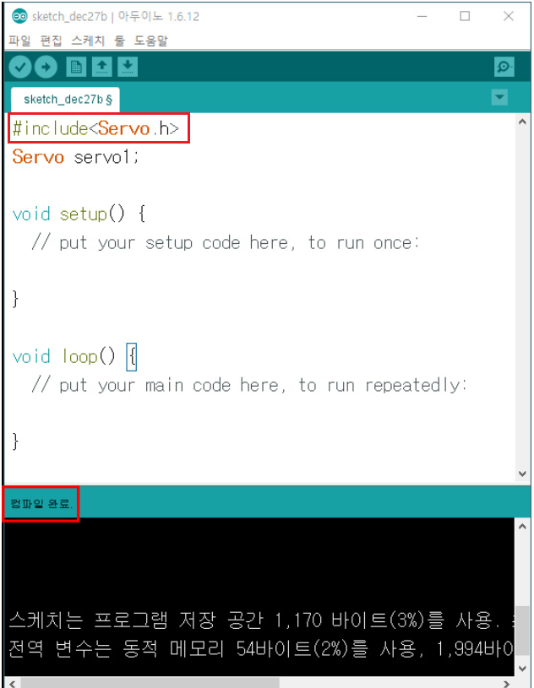
How to add Arduino library
Second-5
Select “Sketch> include Library> Add ZIP Library".
Meaning to use the Servo.h library
If you add a library and compile it,
you can see that it compiles well.

